Slide 1
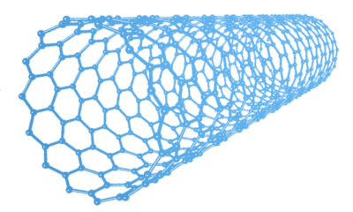
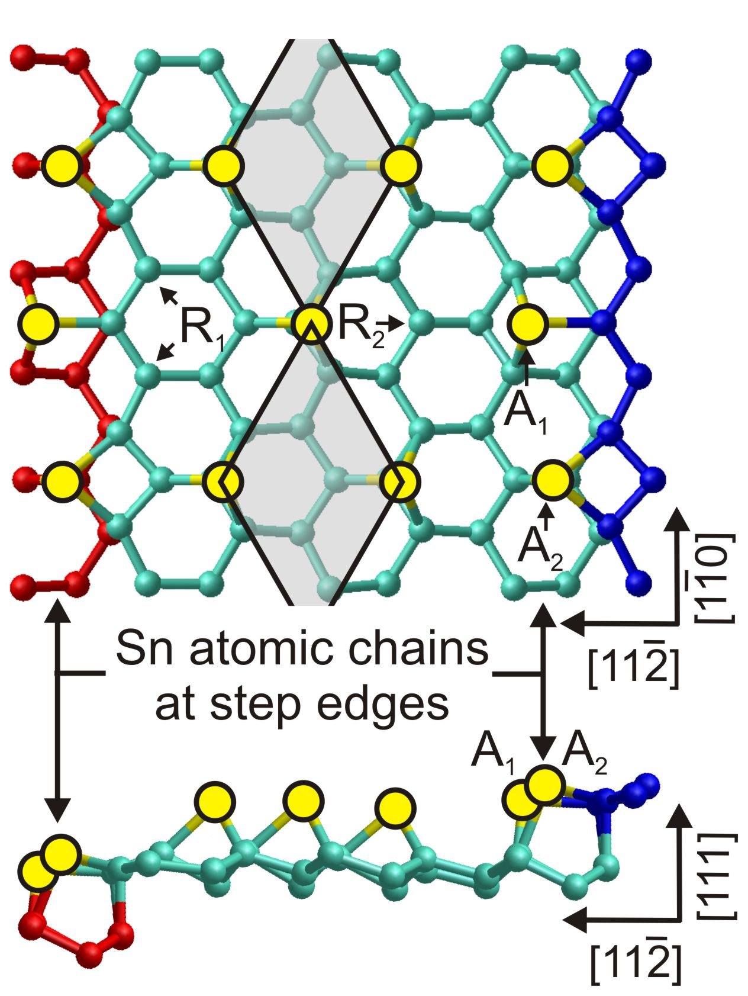
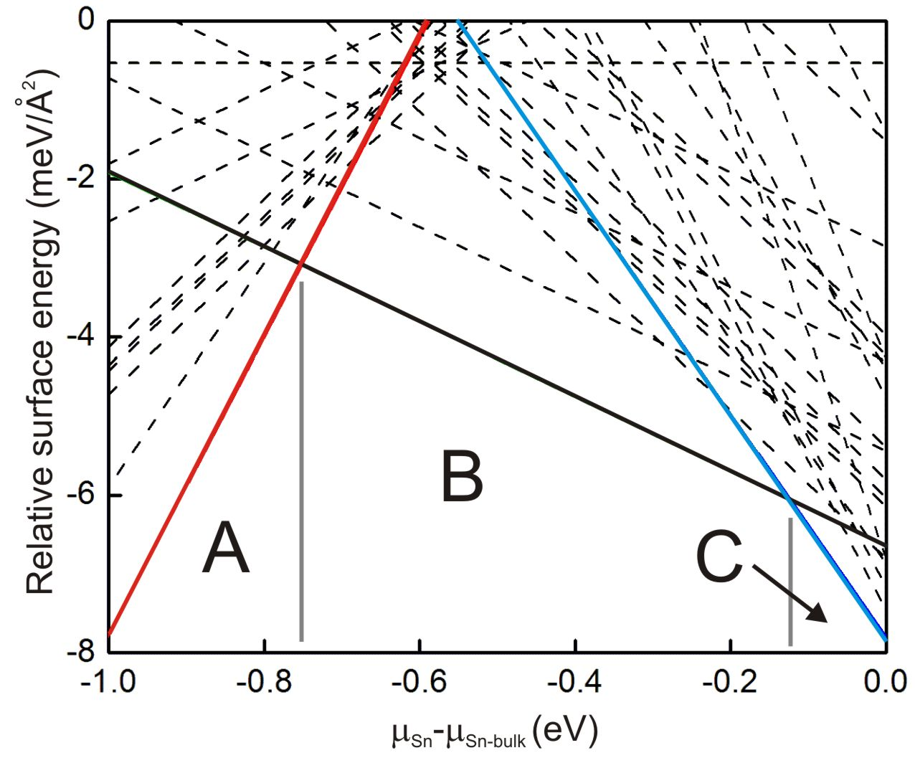
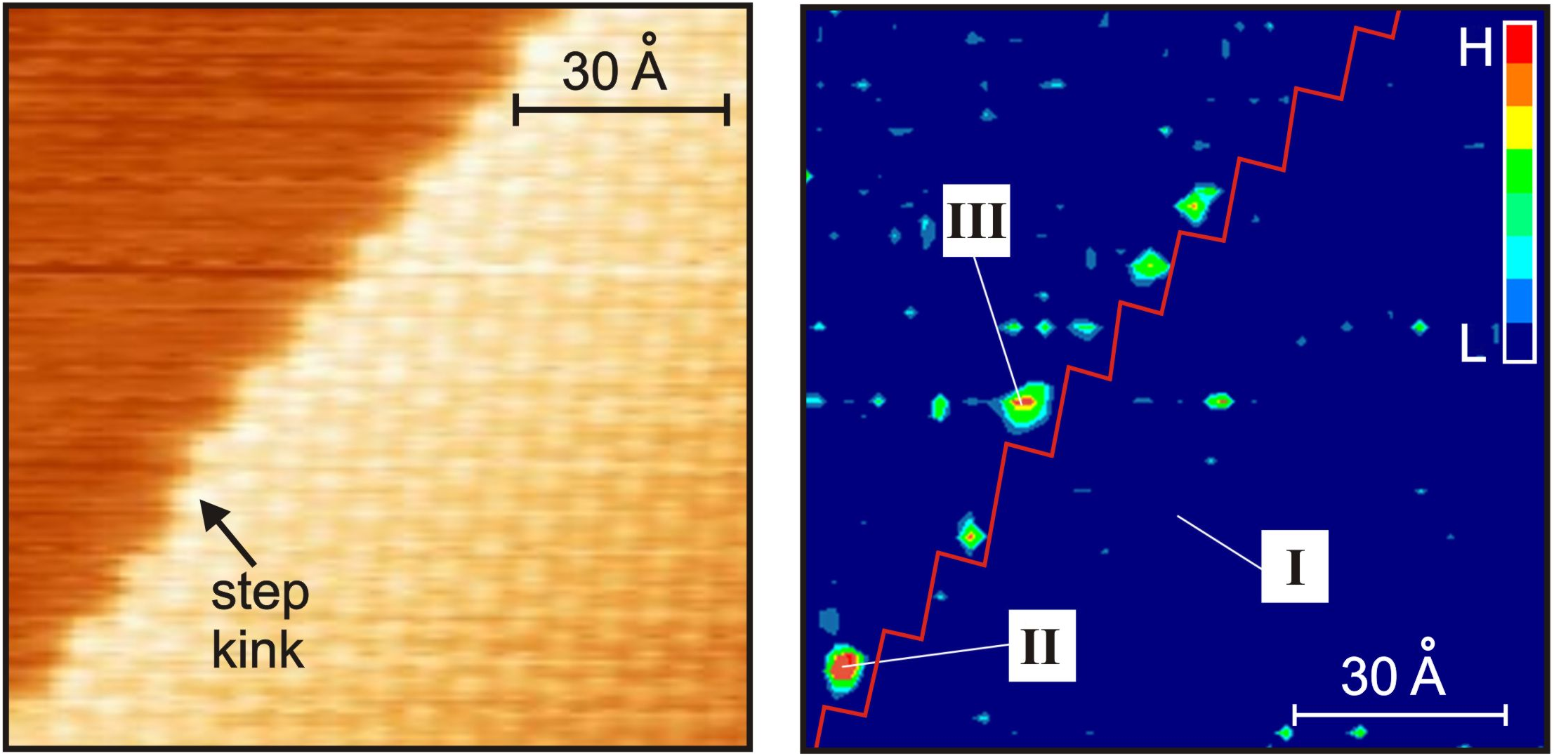
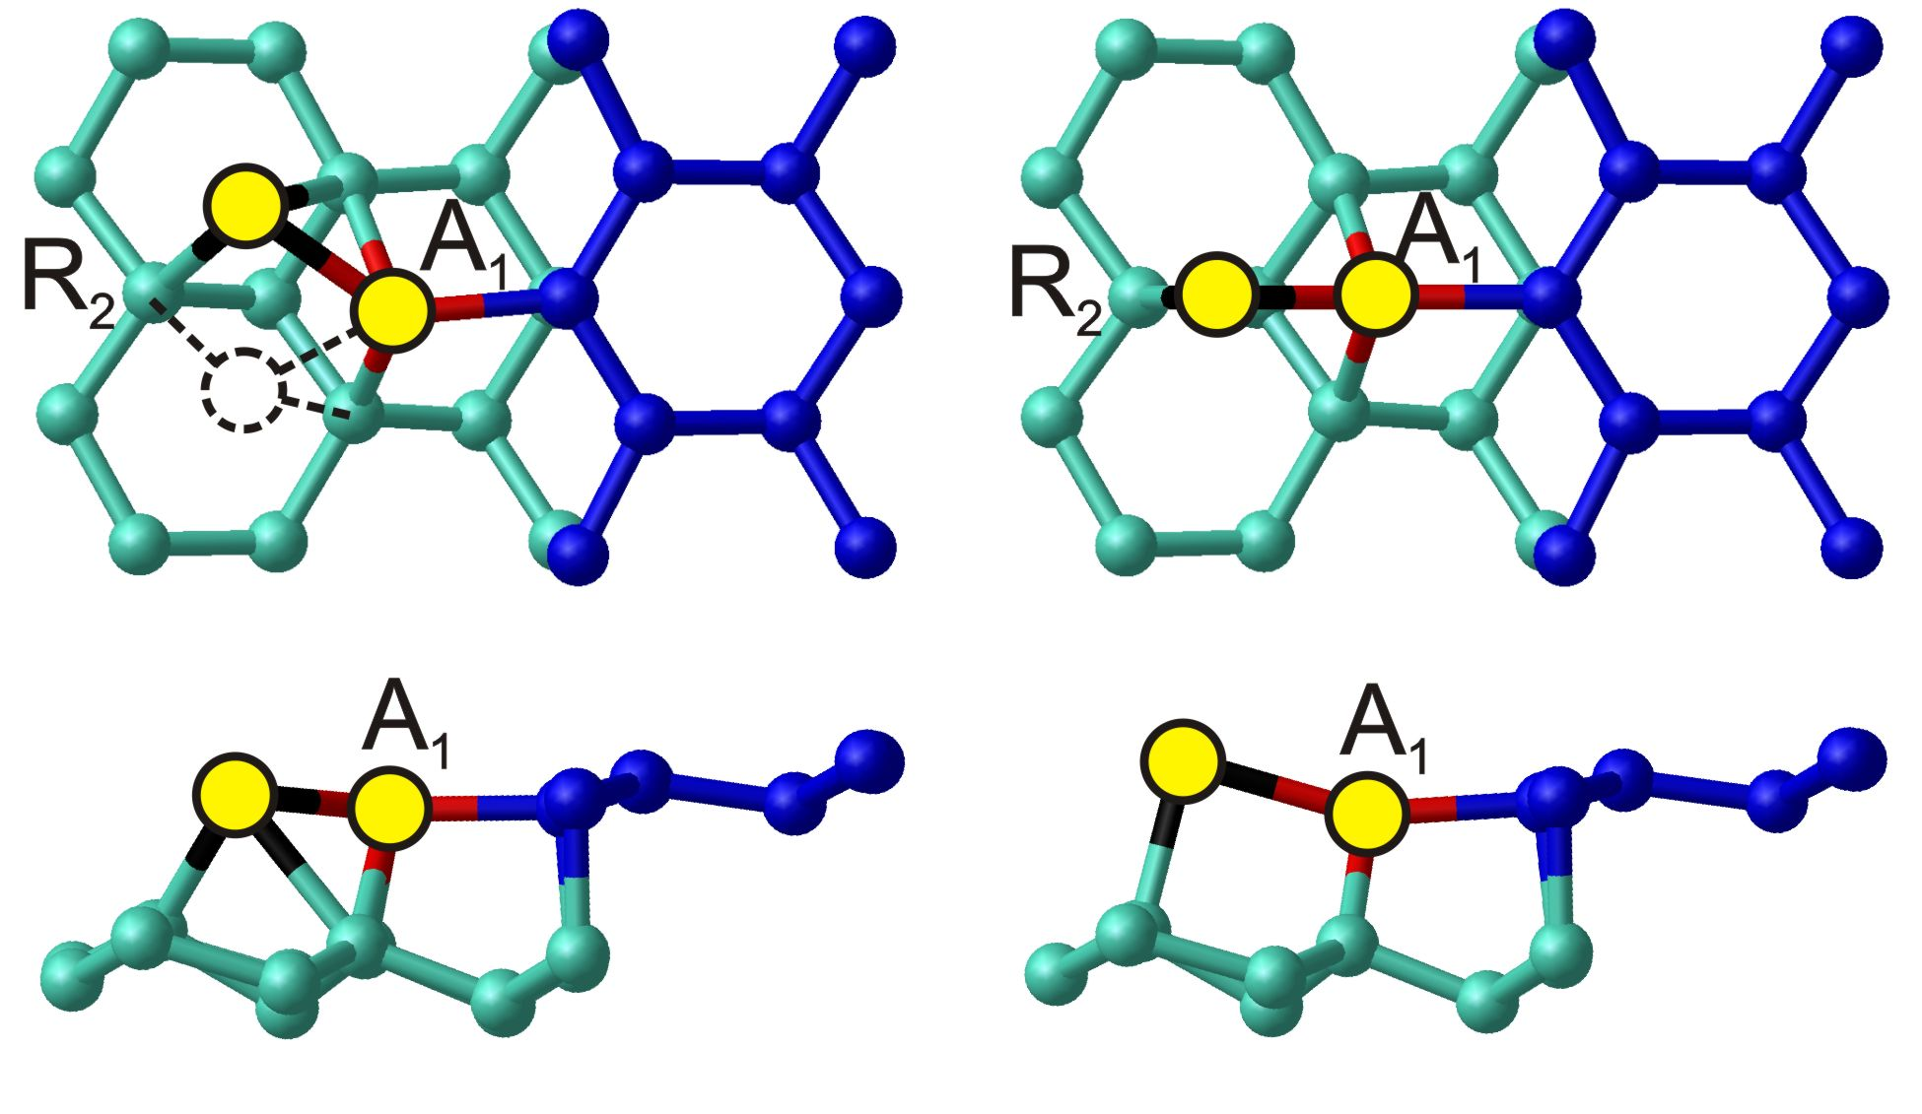
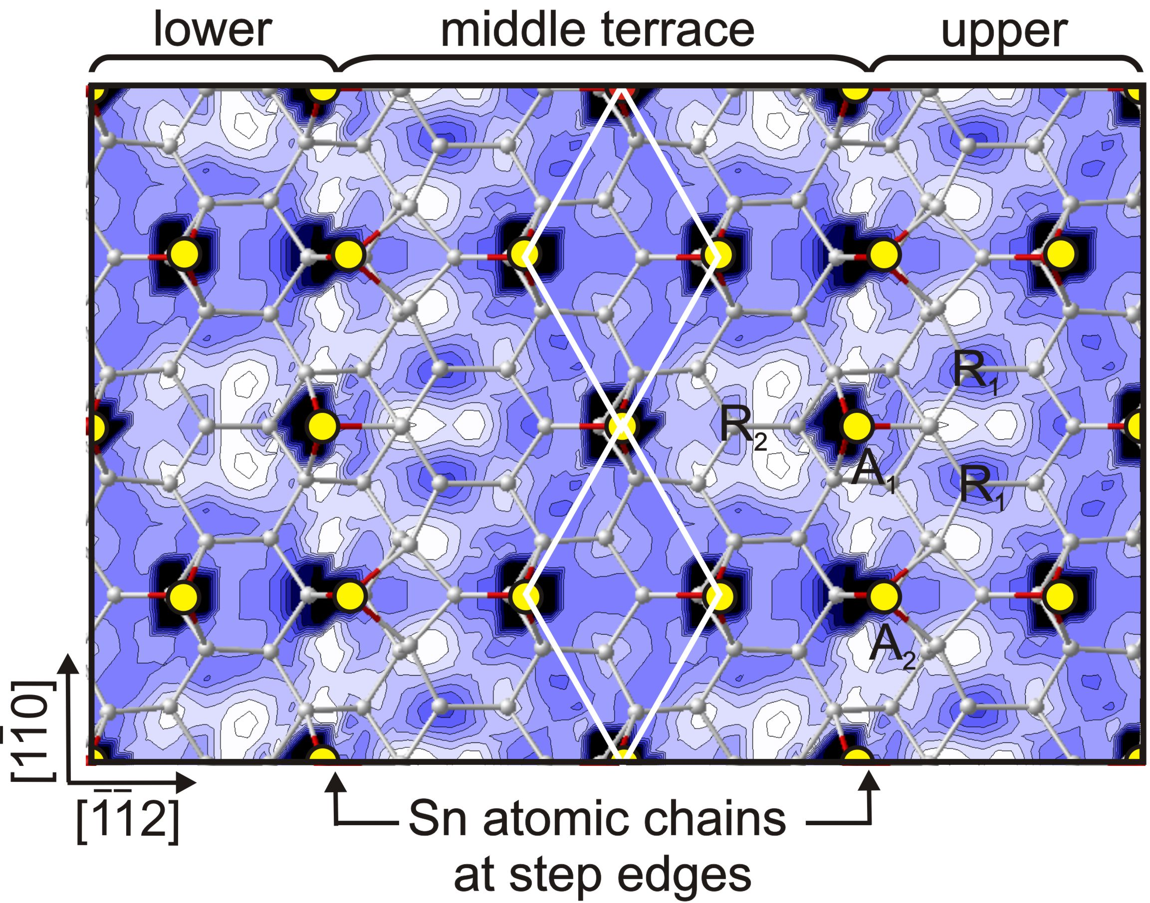
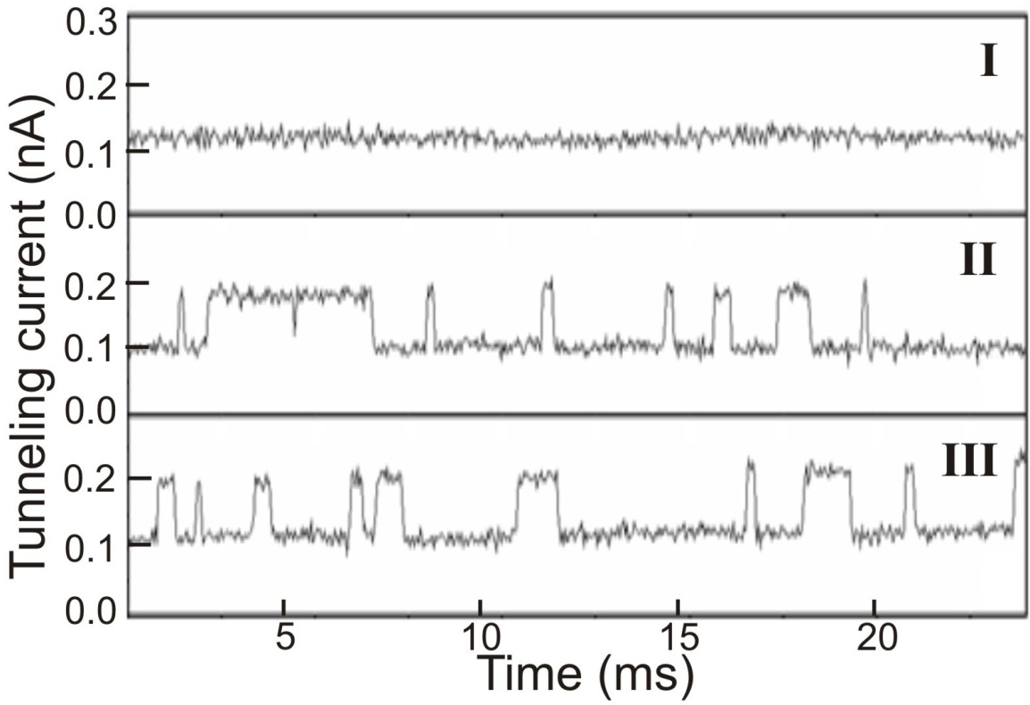
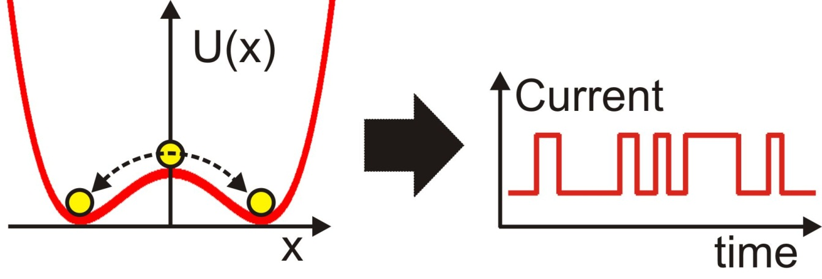
МОСКВА
25-27 ОКТ
III Международная конференция
2021
Математическое моделирование в материаловедении электронных компонентов
Atomic structure of a single step and dynamics of Sn adatoms on the Si(111)-$\sqrt{3}×\sqrt{3}$-Sn surface
R.A. Zhachuk, D.I. Rogilo, A.S. Petrov, D.V. Sheglov, A.V. Latyshev, S. Colonna, F. Ronci
Atomic structure of a single step
Methods: low-temperature scanning tunneling microscopy (LT-STM, Omicron), density functional theory calculations (SIESTA) using generalized gradient approximation (GGA).
References:
R. A. Zhachuk at al., Phys. Rev. B 104 (2021) 125437
F. Ronci et al., Phys. Rev. Lett. 95 (2005) 156101.
F. Ronci et al., Phys. Rev. Lett. 99 (2007) 166103.
F. Ronci et al., J. Phys.: Condens. Matter 22 (2010) 264003.
$\sqrt{3}×\sqrt{3}$-Sn structure
1) Proof: STM images.
U>0
U<0
calculated
Top view
experimental
2) Proof: Lowest calculated surface energy among 50 tested models.
Sideview
Model “B”. Yellow balls – Sn atoms, R₁, R₂ – rest atoms, A₁, A₂ – Sn adatoms forming Sn chains along step edges, red, cyan and blue balls are Si atoms of the lower, middle and upper (111) terraces, respectively.
Dynamics of Sn adatoms at T=80 K
Sn-depleted
Sn-rich
Calculated Potential Energy Surface (PES) for Sn atoms on the Si(111)- $\sqrt{3}×\sqrt{3}$-Sn surface with steps: describes the energetics of adsorbed Sn atom on the reconstructed surface.
Constant current STM image
σ-map: standard deviation of the current traces
-
How does the double well look like?
PES
minima
Saddle
point
Deepest PES minima
(double well)
Top view
$\sqrt{3}×\sqrt{3}$-Sn
structure
Sideview
feedback loop is ON
feedback loop is OFF
weak bond
Current traces
Conclusions:
Step atomic structure is determined.
Dynamics of Sn adatoms near step edges is explained by formation of double wells.
Bright (dark) regions indicate energy
minima (maxima). The contour spacing is 0.2 eV. White circles are Si atoms; yellow circles are Sn atoms.
feedback loop is OFF
The dynamics of Sn adatoms was detected near the steps (bright spots on the σ-map ).

