Slide 1
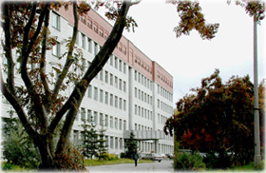
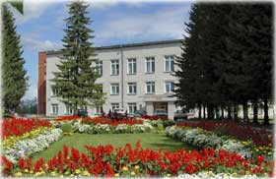
Reasons of crystallite formation during the GaAs nanowire self-catalyzed growth: Monte Carlo simulation
A.G. Nastovjak¹, N.L. Shwartz^{1,2}, E.A. Emelyanov¹, M.O. Petrushkov¹,
¹ Rzhanov Institute of Semiconductor Physics, SB RAS, 13 Lavrentiev aven., 630090, Novosibirsk, Russia
² Novosibirsk State Technical University, 20 K. Marx aven., 630073, Novosibirsk, Russia

Slide 2
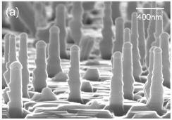
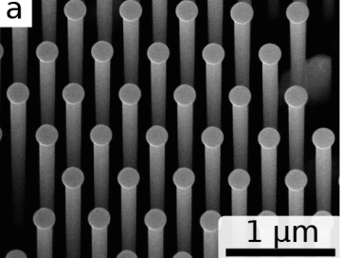
Semiconductor nanowires
Si
GaP
GaAs
R. Dujardin, et. Aa. APL, 89, 153129 (2006) P. 1-3
Oehler, F. et. al, Nano Lett., 2018, 18, 701-708
Preobrazenskii V.V,, Putyato M.A, Emelaynov Е.А., Petrushkov М.О. (ISP SB RAS)

Slide 3
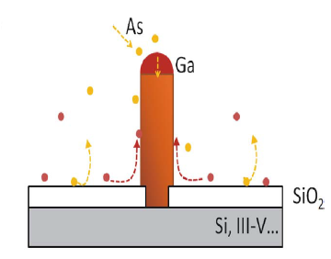
Vapor-liquid-solid growth of A^{III}B^{V} nanowires
Self-catalyzed growth
Morral A., IEEE journal of selected topics in quantum electronics, 2011, 17, 819 -828

Slide 4
Experiment description
GaAs
Oxide removing, buffer deposition

Slide 5
Experiment description
Si deposition
Si
2.7 nm
GaAs
GaAs
Oxide removing, buffer deposition
V_{grSi} = 0.014 ML/s
T_{s} = 410°С, P_{As}< 1·10⁻¹⁰ Torr

Slide 6
Experiment description
Si deposition
Si
2.7 nm
GaAs
GaAs
Oxide removing, buffer deposition
V_{grSi} = 0.014 ML/s
T_{s} = 410°С, P_{As}< 1·10⁻¹⁰ Torr
Si oxidation in airlock MBE chamber (T=300 K)
Ga
As₂
SiO₂
0.5 nm
Si
GaAs
t_{ox} = 40 min

Slide 7
Experiment description
Si deposition
Si
2.7 nm
GaAs
GaAs
Oxide removing, buffer deposition
V_{grSi} = 0.014 ML/s
T_{s} = 410°С, P_{As}< 1·10⁻¹⁰ Torr
NW growth
Ga
Si oxidation in airlock MBE chamber (T=300 K)
Ga
As₂
GaAs
SiO₂
SiO₂
0.5 nm
Si
GaAs
Si
GaAs
T = 620° C
F_{As4}/F_{Ga} = 20
F_{Ga} = 0.23 ML/s
t_{ox} = 40 min

Slide 8
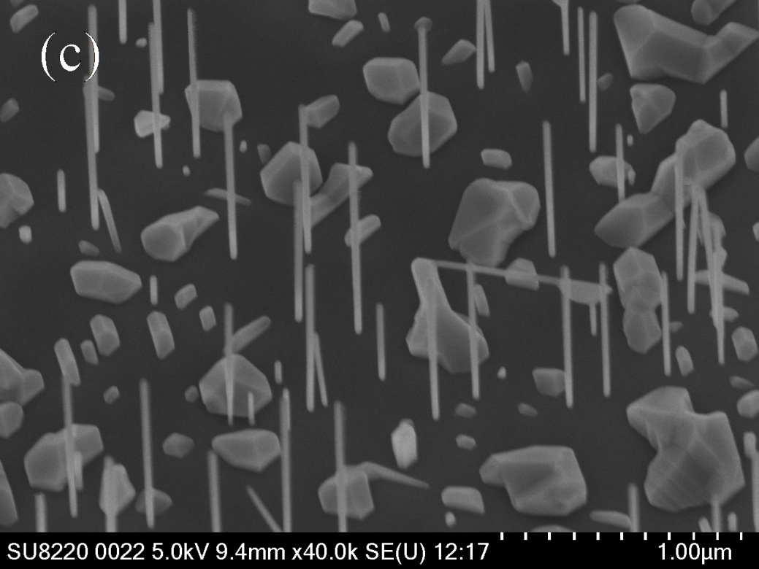
Problem statement
Massive GaAs crystallites form between GaAs NWs
H.Küpers et al, J. Cryst. Growth, 459, 43-49 (2017)
1 μm
F. Matteini et al. Cryst. Growth Des., 16, 5781 (2016)
GaAs(111)B
t_{gr} = 15 min
L ~ 1 μm, d ~ 30 nm.
NW density ~2·10⁷ cm⁻²
F.Bastiman et al, Nanotechnology 27, 095601 (2016)

Slide 9
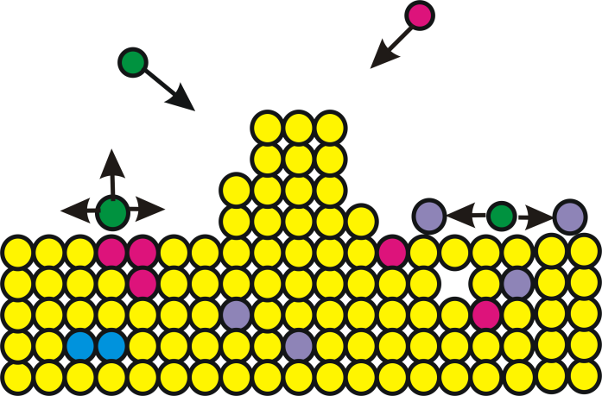
Program package SilSim3D
A.N. Karpov, A.V. Zverev, A.G. Nastovjak, S.V. Usenkov, and N. L. Shwartz, Vychisl. Metody Programm., 15, 3, 388 (2014).
Input parameters of the model system:
composition, crystal structure and orientation of the substrate;
initial layer morphology;
activation energies of possible elementary events (E_{event}) .
Input parameters of the model process:
- temperature T(K);
- flux intensity F(ML/s);
- duration (s)
Diamond-like crystal structure
Cyclic boundary conditions in the lateral directions

Slide 10
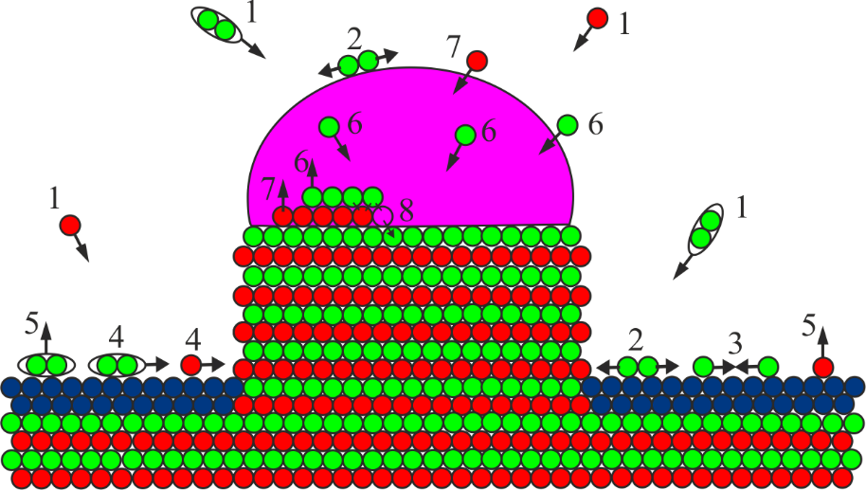
Monte Carlo model
Program package
SilSim3D
A.N. Karpov, A.V. Zverev, A.G. Nastovjak, S.V. Usenkov, and N. L. Shwartz, Vychisl. Metody Programm., 15, 3, 388 (2014).
4
- As₂
9
- As
- Ga(s)
l – liquid phase
s – solid phase
- Ga(l)
- mask film
(1) Ga and As₂ adsorption
(2) As₂ decay As₂ → As + As
(3) As₂ formation As + As → As₂
(4) Particles diffusion
(5) Ga and As₂ desorption
(6) As dissolution and diffusion through the liquid Ga droplet Ga(l)+As → As+Ga(l)
(7) Ga dissolution Ga(s)+Ga(l) → Ga(l)+Ga(l)
(8) GaAs crystallization Ga(l)+As → Ga(s)+As
(9) Mask etching by liquid gallium
Event probability:

Slide 11
Simulation results
Without As diffusion flow
3D view
With As diffusion flow
T = 890 K
F_{As2} = 25 ML/s
F_{Ga} = 10 ML/s
S = 120⋅100 nm

Slide 12
Simulation results
top views
3D view
time
T = 890 K
F_{As2} = 25 ML/s
F_{Ga} = 5 ML/s
S = 120⋅100 nm

Slide 13
Crystallite formation model
Ga
As₂
Ga
As₂
Ga
As₂
SiO₂
Si
GaAs(111)B
GaAs(111)B
GaAs(111)B
t₁
t₂
t₃
Ga
As₂
Ga
As₂
GaAs(111)B
GaAs(111)B
t₅
t₄

Slide 14
Conclusions
Nanowire formation was demonstrated to be accompanied by the parasitic structure growth – massive GaAs clusters and tilted nanowires.
The qualitative model of GaAs cluster formation was proposed and proved by simulation.
During the growth process the growth conditions change: under high arsenic flux the first Ga droplets yield clusters, which collect part of the deposited material, so the subsequent Ga droplets are resulted in nanowire growth.
The self-catalyzed GaAs NW growth is a self-regulated process in which not only external fluxes determine arsenic and gallium flows to a catalyst drop, but these flows are also adjusted by the surface morphology.
ACKNOWLEDGEMENTS
Authors are grateful to T. Gavrilova for acquiring SEM micrographs.
This work was supported by RFBR (grant 18-02-00764)

Slide 15
Thank you for your attention!

Slide 16
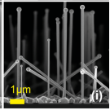
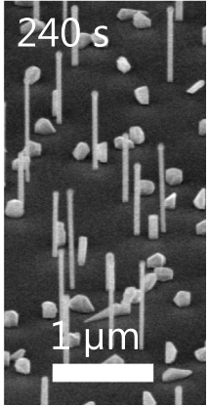
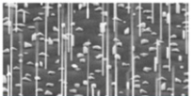
Problem statement
Massive GaAs crystallites form between GaAs NWs
H.Küpers et al, J. Cryst. Growth, 459, 43-49 (2017)
F. Matteini et al. Cryst. Growth Des., 16, 5781 (2016)
F.Bastiman et al, Nanotechnology 27, 095601 (2016)
2 μm

Slide 17
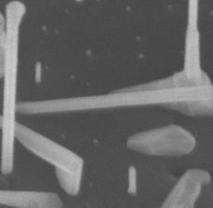
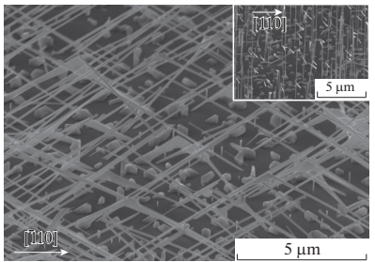
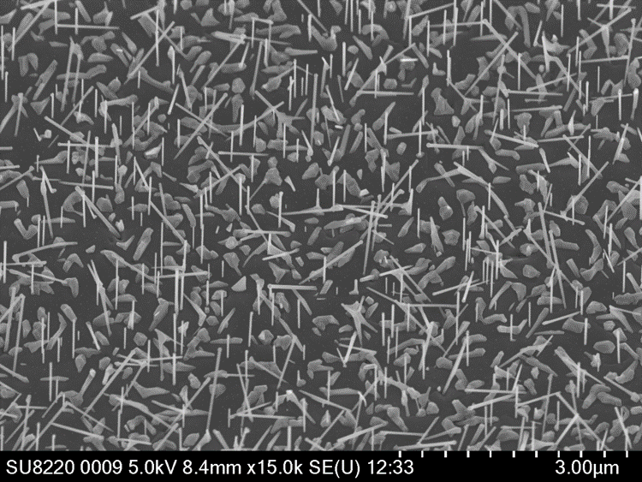
Experiment Nanowire growth
3 μm
GaAs(111)B
t_{gr} = 15 min
L ~ 1 μm, d ~ 30 nm.
NW density ~2·10⁷ cm⁻²
GaAs(100)
t_{gr} = 60 min
L ~ 6-8 μm, d ~ 90 nm.
NW density ~3·10⁷ сm⁻²
L – NW length, d – NW diameter

